Slide 1


Chapter 7
Inheritance
Copyright © 2010 Pearson Addison-Wesley. All rights reserved.

Slide 2
Introduction to Inheritance
Inheritance is one of the main techniques of object-oriented programming (OOP)
Using this technique, a very general form of a class is first defined and compiled, and then more specialized versions of the class are defined by adding instance variables and methods
The specialized classes are said to inherit the methods and instance variables of the general class

Slide 3
Introduction to Inheritance
Inheritance is the process by which a new class is created from another class
The new class is called a subclass
The original class is called the super class
A subclass automatically has all the instance variables and methods that the super class has, and it can have additional methods and/or instance variables as well
Inheritance is especially advantageous because it allows code to be reused, without having to copy it into the definitions of the subclasses

Slide 4
Subclasses
When designing certain classes, there is often a natural hierarchy for grouping them
In a record-keeping program for the employees of a company, there are hourly employees and salaried employees
Hourly employees can be divided into full time and part time workers
Salaried employees can be divided into those on technical staff, and those on the executive staff

Slide 5
subclasses
All employees share certain characteristics in common
All employees have a name and a hire date
The methods for setting and changing names and hire dates would be the same for all employees
Some employees have specialized characteristics
Hourly employees are paid an hourly wage, while salaried employees are paid a fixed wage
The methods for calculating wages for these two different groups would be different

Slide 6
subclasses
Within Java, a class called Employee can be defined that includes all employees
This class can then be used to define classes for hourly employees and salaried employees
In turn, the HourlyEmployee class can be used to define a PartTimeHourlyEmployee class, and so forth

Slide 7
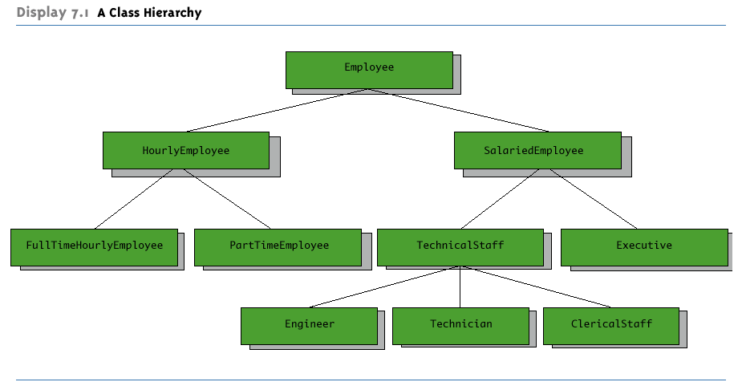
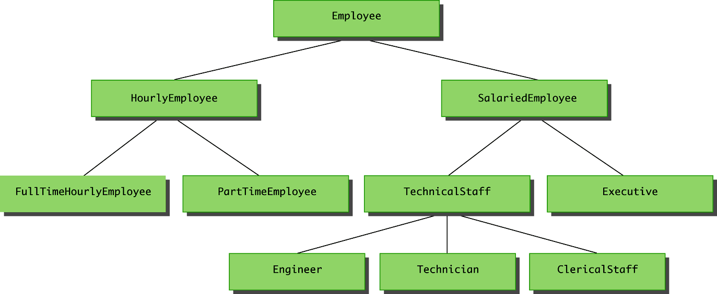
A Class Hierarchy

Slide 8
subclasses
Since an hourly employee is an employee, it is defined as a subclass of the class Employee
A subclass is defined by adding instance variables and methods to an existing class
The existing class that the subclass is built upon is called the super class
The phrase extends BaseClass must be added to the subclass definition:
public class HourlyEmployee extends Employee

Slide 9
subclasses
When a subclass is defined, it is said to inherit the instance variables and methods of the super class that it extends
Class Employee defines the instance variables name and hireDate in its class definition
Class HourlyEmployee also has these instance variables, but they are not specified in its class definition
Class HourlyEmployee has additional instance variables wageRate and hours that are specified in its class definition

Slide 10
subclasses
Just as it inherits the instance variables of the class Employee, the class HourlyEmployee inherits all of its methods as well
The class HourlyEmployee inherits the methods getName, getHireDate, setName, and setHireDate from the class Employee
Any object of the class HourlyEmployee can invoke one of these methods, just like any other method

Slide 11
Subclass (Derived class)
A subclass, also called a derived class, is defined by starting with another already defined class, called a super class or base class, and adding (and/or changing) methods, instance variables, and static variables
The subclass inherits all the public methods, all the public and private instance variables, and all the public and private static variables from the super class
The subclass can add more instance variables, static variables, and/or methods

Slide 12
Inherited Members
A subclass automatically has all the instance variables, all the static variables, and all the public methods of the super class
Members from the super class are said to be inherited
Definitions for the inherited variables and methods do not appear in the subclass
The code is reused without having to explicitly copy it, unless the creator of the subclass redefines one or more of the super class methods

Slide 13
Parent and Child Classes
A super class is often called the parent class
A subclass is then called a child class
These relationships are often extended such that a class that is a parent of a parent . . . of another class is called an ancestor class
If class A is an ancestor of class B, then class B can be called a descendent of class A

Slide 14
Overriding a Method Definition
Although a subclass inherits methods from the super class, it can change or override an inherited method if necessary
In order to override a method definition, a new definition of the method is simply placed in the class definition, just like any other method that is added to the subclass

Slide 15
Pitfall: Overriding Versus Overloading
Do not confuse overriding a method in a subclass with overloading a method name
When a method is overridden, the new method definition given in the subclass has the exact same number and types of parameters as in the super class
When a method in a subclass has a different signature from the method in the super class, that is overloading
Note that when the subclass overloads the original method, it still inherits the original method from the super class as well

Slide 16
The final Modifier
If the modifier final is placed before the definition of a method, then that method may not be redefined in a subclass
It the modifier final is placed before the definition of a class, then that class may not be used as a super class to derive other classes

Slide 17
The super Constructor
A subclass uses a constructor from the super class to initialize all the data inherited from the super class
In order to invoke a constructor from the super class, it uses a special syntax:
public derivedClass(int p1, int p2, double p3)
{
super(p1, p2);
instanceVariable = p3;
}
In the above example, super(p1, p2); is a call to the super class constructor

Slide 18
The super Constructor
A call to the super class constructor can never use the name of the super class, but uses the keyword super instead
A call to super must always be the first action taken in a constructor definition
An instance variable cannot be used as an argument to super

Slide 19
The super Constructor
If a subclass constructor does not include an invocation of super, then the no-argument constructor of the super class will automatically be invoked
This can result in an error if the super class has not defined a no-argument constructor
Since the inherited instance variables should be initialized, and the super class constructor is designed to do that, then an explicit call to super should always be used

Slide 20
The this Constructor
Within the definition of a constructor for a class, this can be used as a name for invoking another constructor in the same class
The same restrictions on how to use a call to super apply to the this constructor
If it is necessary to include a call to both super and this, the call using this must be made first, and then the constructor that is called must call super as its first action

Slide 21
The this Constructor
Often, a no-argument constructor uses this to invoke an explicit-value constructor
No-argument constructor (invokes explicit-value constructor using this and default arguments):
public ClassName()
{
this(argument1, argument2);
}
Explicit-value constructor (receives default values):
public ClassName(type1 param1, type2 param2)
{
. . .
}

Slide 22
The this Constructor
public HourlyEmployee()
{
this("No name", new Date(), 0, 0);
}
The above constructor will cause the constructor with the following heading to be invoked:
public HourlyEmployee(String theName, Date theDate, double theWageRate, double theHours)

Slide 23
Tip: An Object of a subclass Has More than One Type
An object of a subclass has the type of the subclass, and it also has the type of the super class
More generally, an object of a subclass has the type of every one of its ancestor classes
Therefore, an object of a subclass can be assigned to a variable of any ancestor type

Slide 24
Tip: An Object of a subclass Has More than One Type
An object of a subclass can be plugged in as a parameter in place of any of its ancestor classes
In fact, a subclass object can be used anyplace that an object of any of its ancestor types can be used
Note, however, that this relationship does not go the other way
An ancestor type can never be used in place of one of its derived types

Slide 25
Pitfall: The Terms "Subclass" and "Superclass"
The terms subclass and superclass are sometimes mistakenly reversed
A super class or base class is more general and inclusive, but less complex
A subclass or derived class is more specialized, less inclusive, and more complex
As more instance variables and methods are added, the number of objects that can satisfy the class definition becomes more restricted

Slide 26
Encapsulation and Inheritance Pitfall: Use of Private Instance Variables from the super class
An instance variable that is private in a super class is not accessible by name in the definition of a method in any other class, not even in a method definition of a subclass
For example, an object of the HourlyEmployee class cannot access the private instance variable hireDate by name, even though it is inherited from the Employee super class
Instead, a private instance variable of the super class can only be accessed by the public accessor and mutator methods defined in that class
An object of the HourlyEmployee class can use the getHireDate or setHireDate methods to access hireDate

Slide 27
Encapsulation and Inheritance Pitfall: Use of Private Instance Variables from the super class
If private instance variables of a class were accessible in method definitions of a subclass, then anytime someone wanted to access a private instance variable, they would only need to create a subclass, and access it in a method of that class
This would allow private instance variables to be changed by mistake or in inappropriate ways (for example, by not using the base type's accessor and mutator methods only)

Slide 28
Pitfall: Private Methods Are Effectively Not Inherited
The private methods of the super class are like private variables in terms of not being directly available
However, a private method is completely unavailable, unless invoked indirectly
This is possible only if an object of a subclass invokes a public method of the super class that happens to invoke the private method
This should not be a problem because private methods should just be used as helping methods
If a method is not just a helping method, then it should be public, not private

Slide 29
Protected and Package Access
If a method or instance variable is modified by protected (rather than public or private), then it can be accessed by name
Inside its own class definition
Inside any class derived from it
In the definition of any class in the same package
The protected modifier provides very weak protection compared to the private modifier
It allows direct access to any programmer who defines a suitable subclass
Therefore, instance variables should normally not be marked protected

Slide 30
Protected and Package Access
An instance variable or method definition that is not preceded with a modifier has package access
Package access is also known as default or friendly access
Instance variables or methods having package access can be accessed by name inside the definition of any class in the same package
However, neither can be accessed outside the package

Slide 31
Protected and Package Access
Note that package access is more restricted than protected
Package access gives more control to the programmer defining the classes
Whoever controls the package directory (or folder) controls the package access

Slide 32
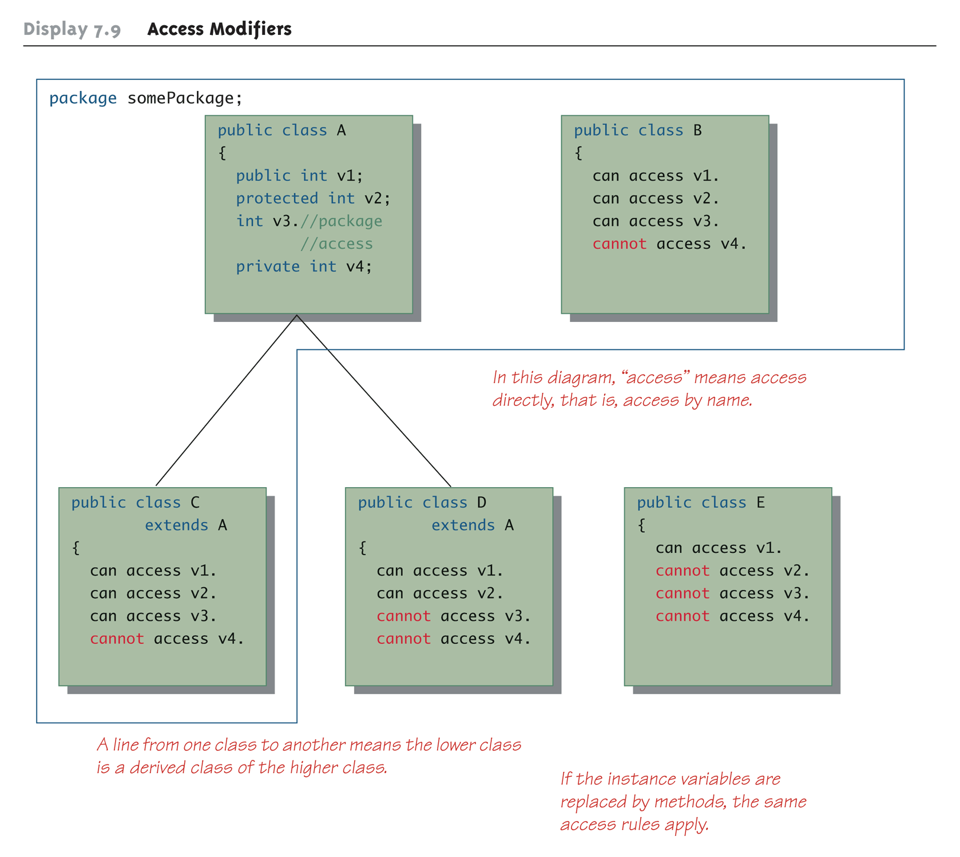
Access Modifiers

Slide 33
Pitfall: Forgetting About the Default Package
When considering package access, do not forget the default package
All classes in the current directory (not belonging to some other package) belong to an unnamed package called the default package
If a class in the current directory is not in any other package, then it is in the default package
If an instance variable or method has package access, it can be accessed by name in the definition of any other class in the default package

Slide 34
Pitfall: A Restriction on Protected Access
If a class B is derived from class A, and class A has a protected instance variable n, but the classes A and B are in different packages, then the following is true:
A method in class B can access n by name (n is inherited from class A)
A method in class B can create a local object of itself, which can access n by name (again, n is inherited from class A)

Slide 35
Pitfall: A Restriction on Protected Access
However, if a method in class B creates an object of class A, it can not access n by name
A class knows about its own inherited variables and methods
However, it cannot directly access any instance variable or method of an ancestor class unless they are public
Therefore, B can access n whenever it is used as an instance variable of B, but B cannot access n when it is used as an instance variable of A
This is true if A and B are not in the same package
If they were in the same package there would be no problem, because protected access implies package access

Slide 36
Tip: "Is a" Versus "Has a"
A subclass demonstrates an "is a" relationship between it and its super class
Forming an "is a" relationship is one way to make a more complex class out of a simpler class
For example, an HourlyEmployee "is an" Employee
HourlyEmployee is a more complex class compared to the more general Employee class

Slide 37
Tip: "Is a" Versus "Has a"
Another way to make a more complex class out of a simpler class is through a "has a" relationship
This type of relationship, called composition, occurs when a class contains an instance variable of a class type
The Employee class contains an instance variable, hireDate, of the class Date, so therefore, an Employee "has a" Date

Slide 38
Tip: "Is a" Versus "Has a"
Both kinds of relationships are commonly used to create complex classes, often within the same class
Since HourlyEmployee is a subclass of Employee, and contains an instance variable of class Date, then HourlyEmployee "is an" Employee and "has a" Date

Slide 39
Tip: Static Variables Are Inherited
Static variables in a super class are inherited by any of its subclasses
The modifiers public, private, and protected, and package access have the same meaning for static variables as they do for instance variables

Slide 40
Access to a Redefined Super class Method
Within the definition of a method of a subclass, the super class version of an overridden method of the super class can still be invoked
Simply preface the method name with super and a dot
public String toString()
{
return (super.toString() + "$" + wageRate);
}
However, using an object of the subclass outside of its class definition, there is no way to invoke the super class version of an overridden method

Slide 41
END

